Slide 1
Clustering Victims of Domestic Violence to Tailor Outreach Strategies
India DHS Surveys 2015-2016
Mary Scott Sanders 10/2018
Notes:
Clustering is a type of ml typically used for marketing purposes that help marketers find the major groups within their customer base/audience so that they can tailor their strategies to each of those major groups accordingly. K Means clustering in particular allows you to specify a group of features that you would like to use to segment the audience and a number of groups you would like to end up with.

Slide 2
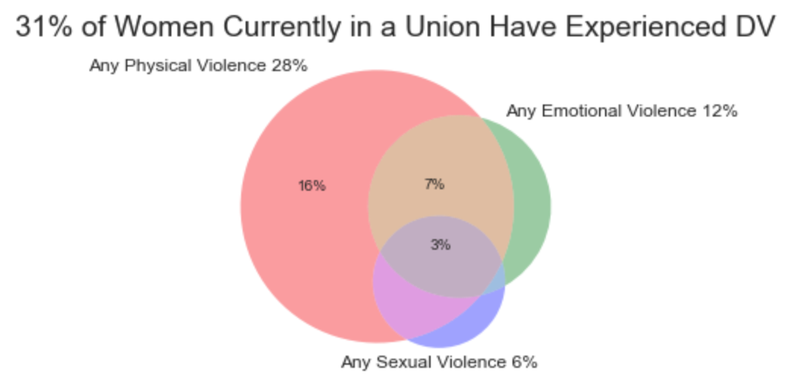
Domestic Violence is a Pervasive in India

Slide 3
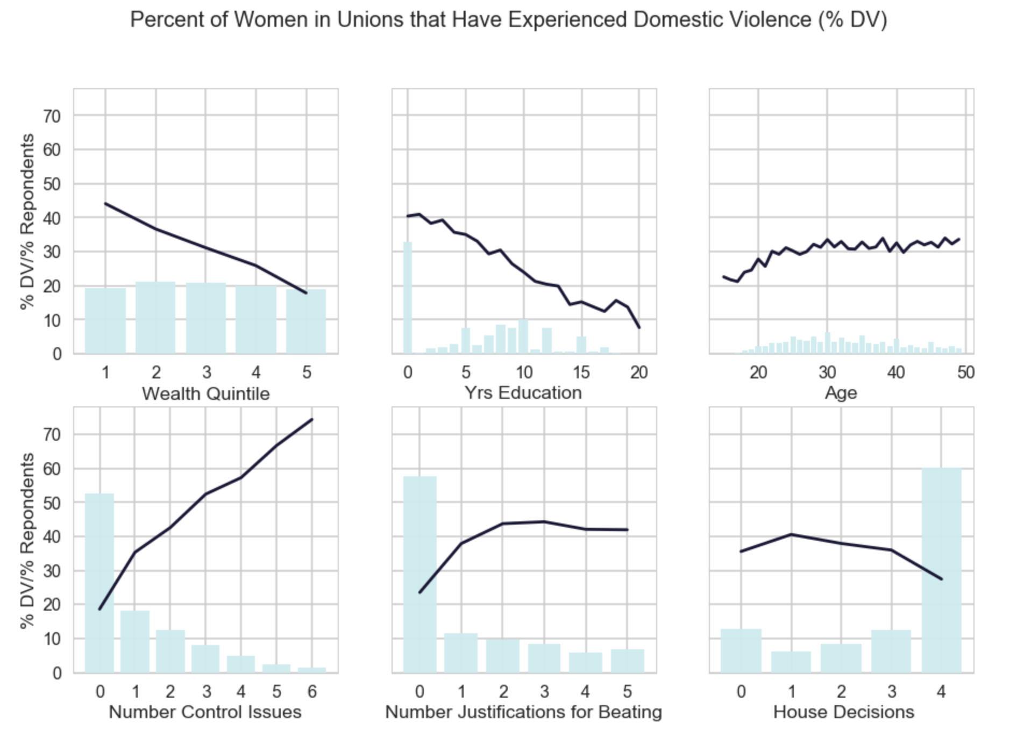
Domestic Violence is a Complex Problem

Slide 4
Domestic Violence Requires a Complex Set of Solutions
Proper Legislation
Police and Prosecutor Training
Medical Professional Training and Additional Crisis Centers
Social Campaigns portion this analysis aims to address

Slide 5
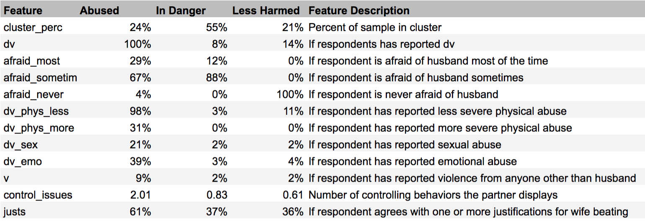
Results from Clustering by Experience with DVering by Experience with Domestic Violence
Method: K-Means clustering set to find 3 groups (k=3)
Abused Group: Experience many forms of dv, often afraid.
In Danger Group: Mostly do not report dv. However, partners display controlling behaviors, often afraid.
Less Harmed Group: Mostly do not report dv, not afraid of partners.

Slide 6
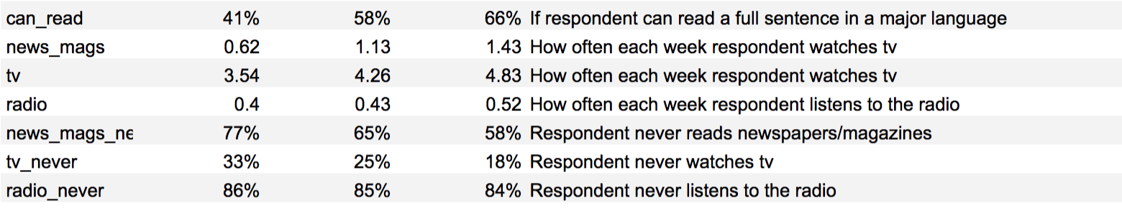
Results from Clustering by Experience with DVering by Experience with Domestic Violence
Abused group has least interactions with media, is least accessible
Out of media, Abused interacts with tv the most, which is the most equitable medium.
Less Harmed group is best educated, wealthier, and the most access to technology, while the In Danger group sits between others in most metrics.

Slide 7
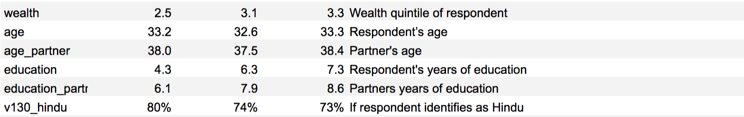
Results from Clustering by Experience with DVering by Experience with Domestic Violence
Wealth and education are negatively correlated with abuse.
The Abused group has the least education, therefore in order for education to have an impact, curriculum regarding dv must begin early.

Slide 8
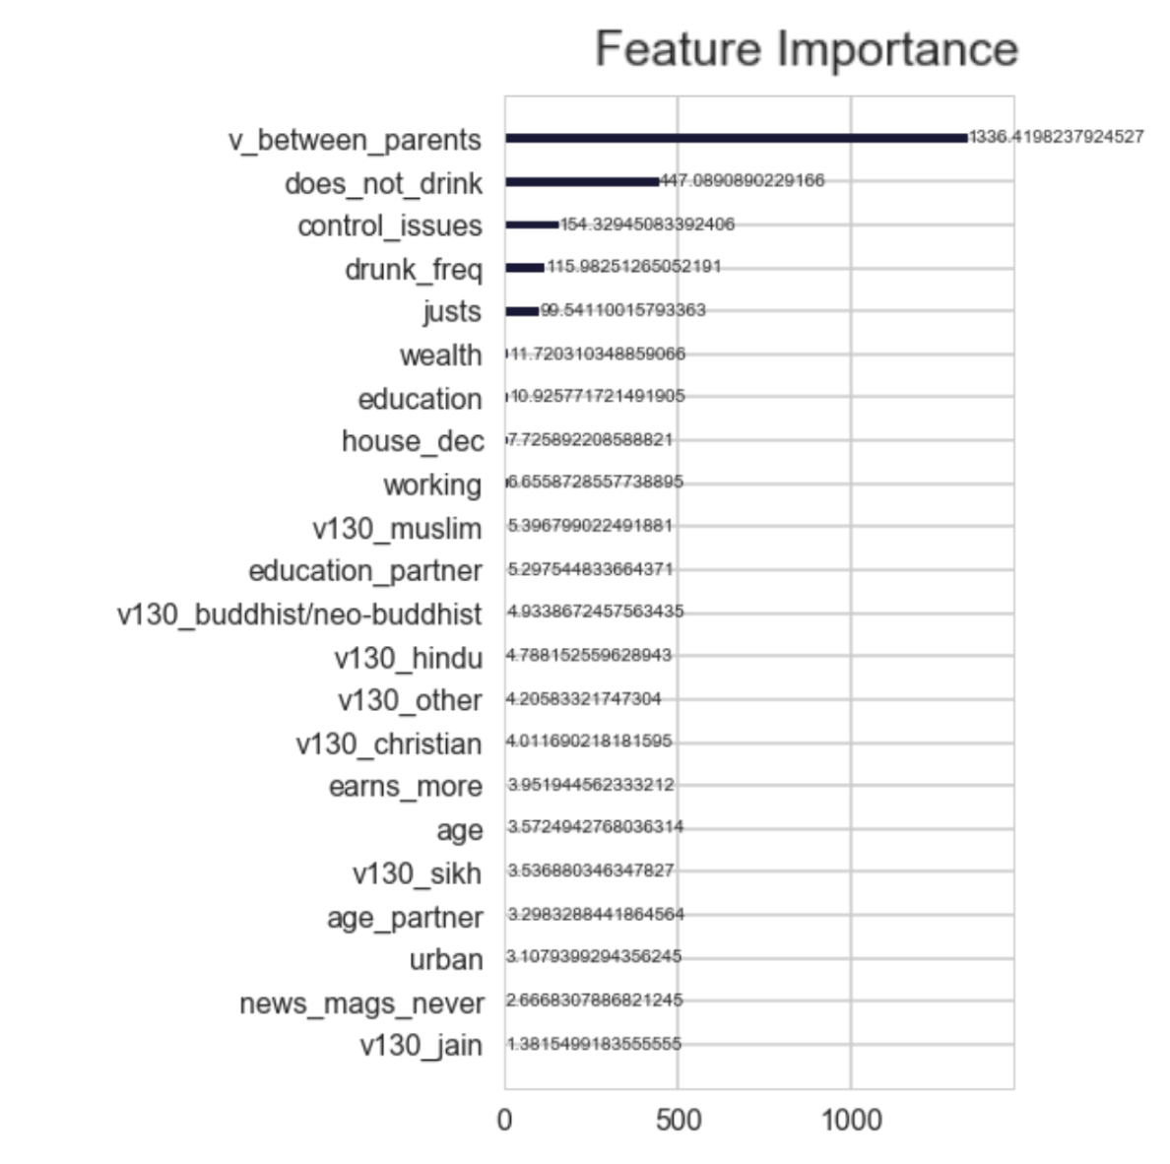

Results from Gradient Boosting Classification
Used XGBClassification to predict if a woman would report any violence
While performance was underwhelming, was valuable to understand relative importance of features
Results from Gradient Boosting Model with GridSearchCV Tuning
AUC | 67.2%
Accuracy | 75.0%
Recall | 44.9%
Precision | 67.7%
Best colsample_by_tree | 30.0%
Best max_depth | 5

Slide 9
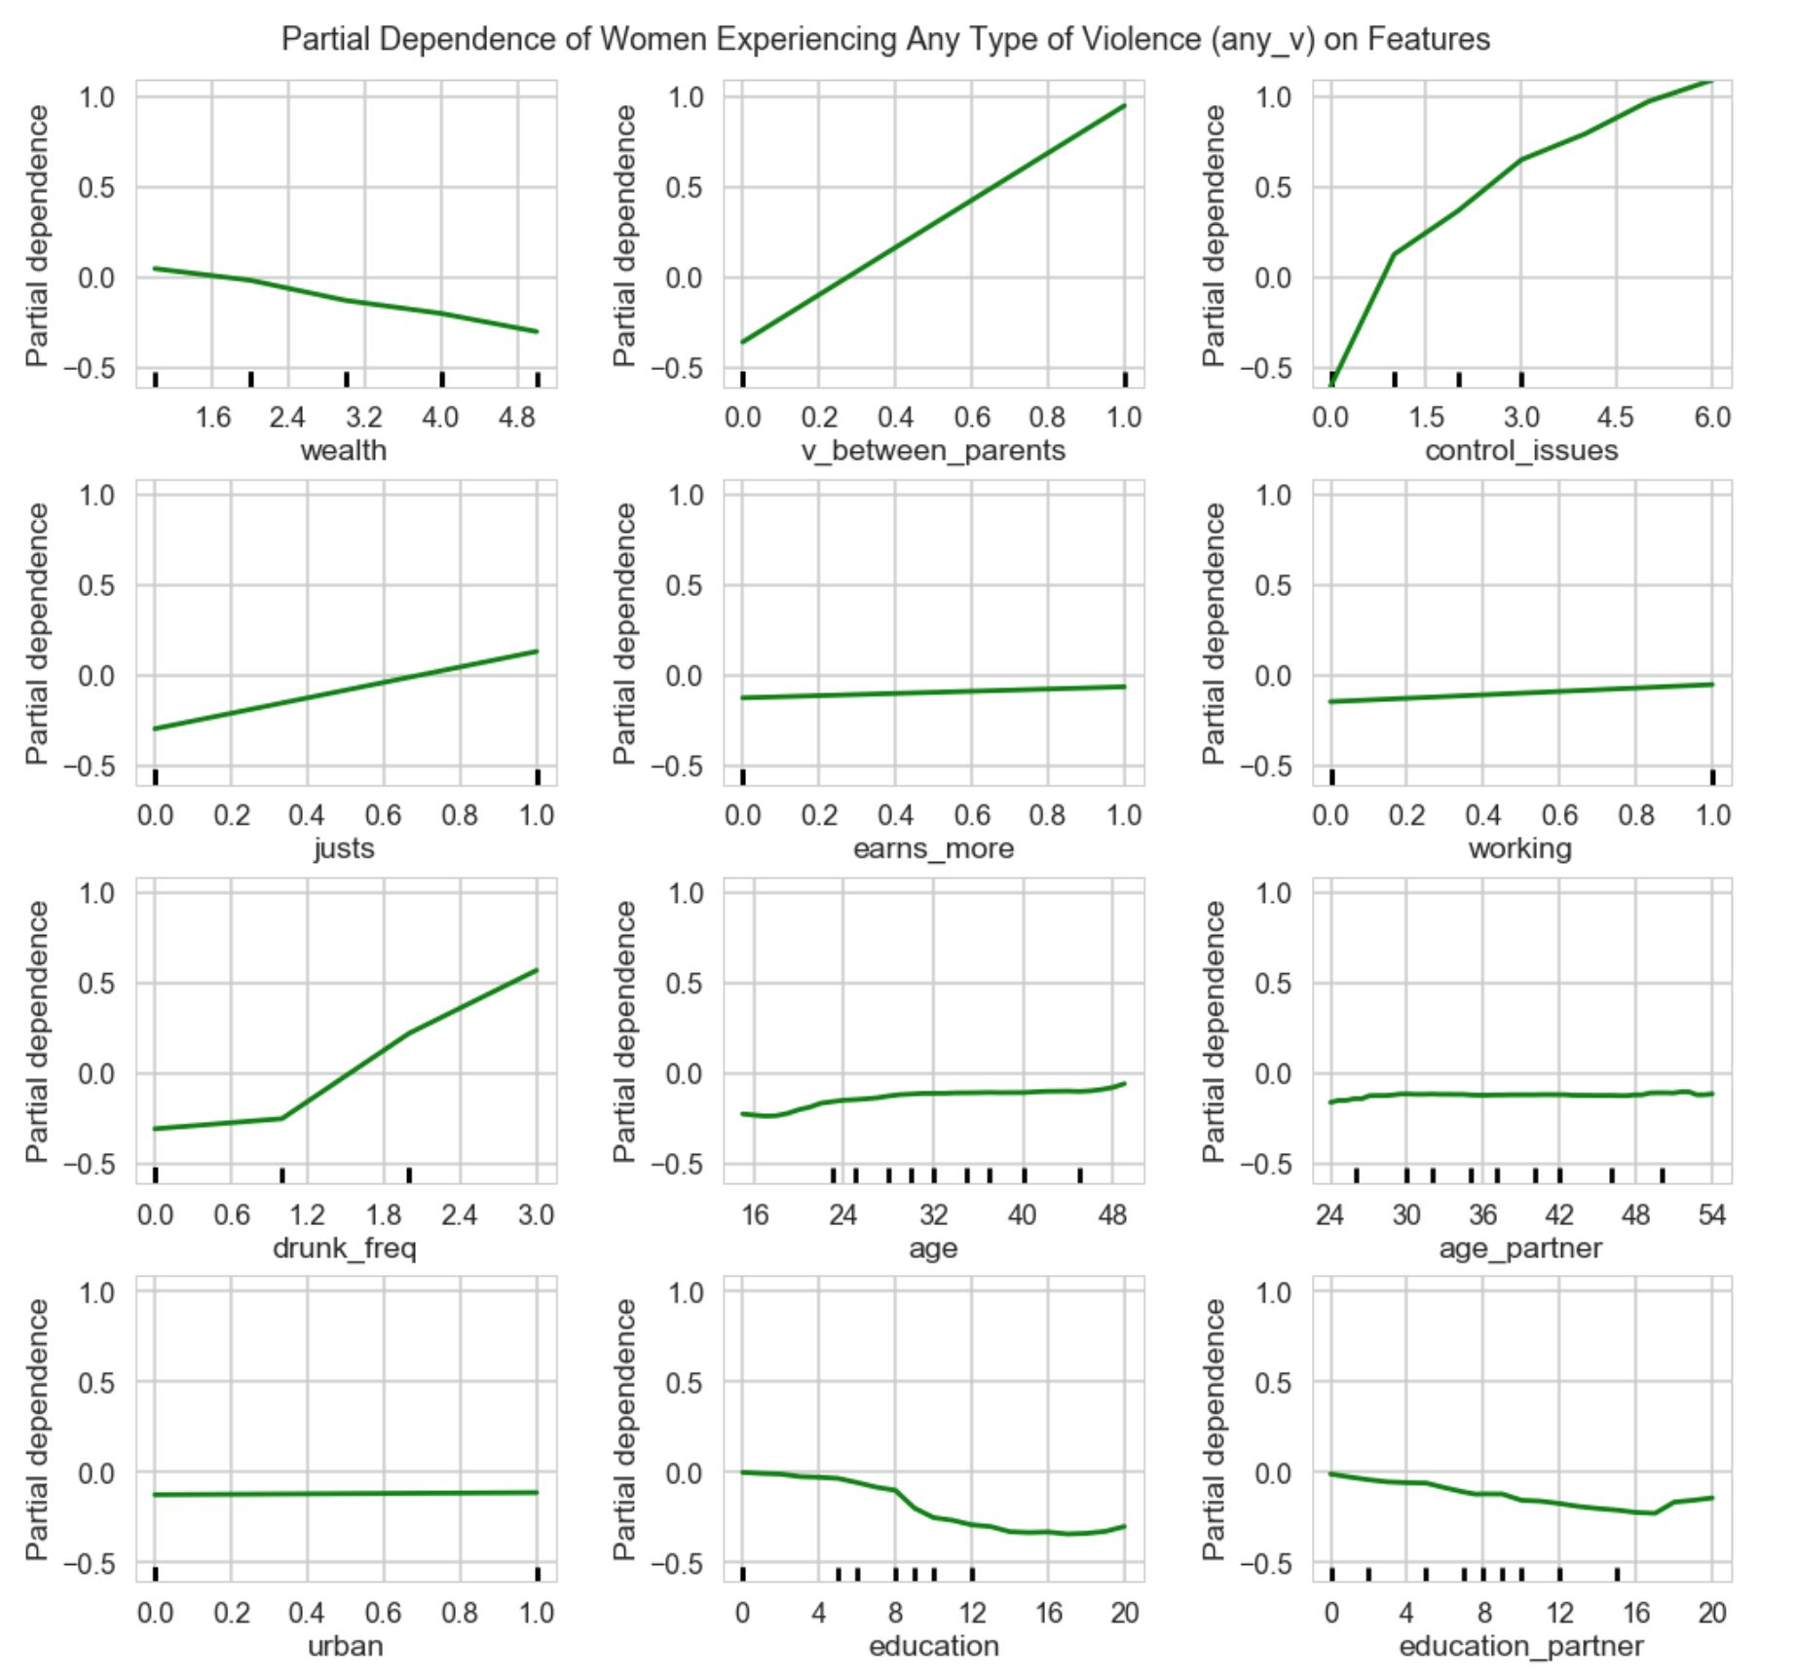
Partial Dependence of Women Experiencing Any Violence
While socioeconomic factors (wealth and education) do matter, behavioral factors (control issues, drunkenness, and violence between parents, agreeing with justifications for violence) seem to be dominant features.
Women’s age and education seem to matter more than men’s
While behavioral features seem to be stronger drivers of dv, socioeconomic features are still very useful in targeting high risk audiences.

Slide 10
Recommendations
Mechanisms
TV: “Abused” group hardest to reach, but most accessible via tv
Schools: Should be leveraged, but need to start early, “Abused” group’s partners average 6 yrs education
Messages
Target less educated, lower income, more rural audiences
Address associated behavioral issues in addition to domestic violence
Convert 20% of partner’s from “not abusive or antagonistic” to “advocates.”
Convert 50% of partners from “antagonistic but not abusive” to “not antagonistic.”
Convert 30% of partners from “abusive” to “not abusive.”
Convert 42% women from agreeing with justifications for beating. Affirm worth.
Educate 20% of women who are abused but not reporting on how to access resources

